Slide 1






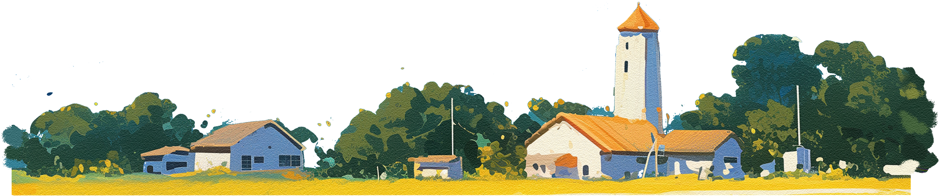
Computer Science Fundamentals & Career Pathways
Course Code: ETCCCP105
Domain Research
INTERNET OF THINGS (IOT)
Soumya Subhashri Sahoo
BTech CSE (AI&ML) - B

Slide 2
Page 01
slides
OVERVIEW
About IOT
key technologiees
required skills checklist
refecence and further journals
career opportunities
real - world use case

Slide 3

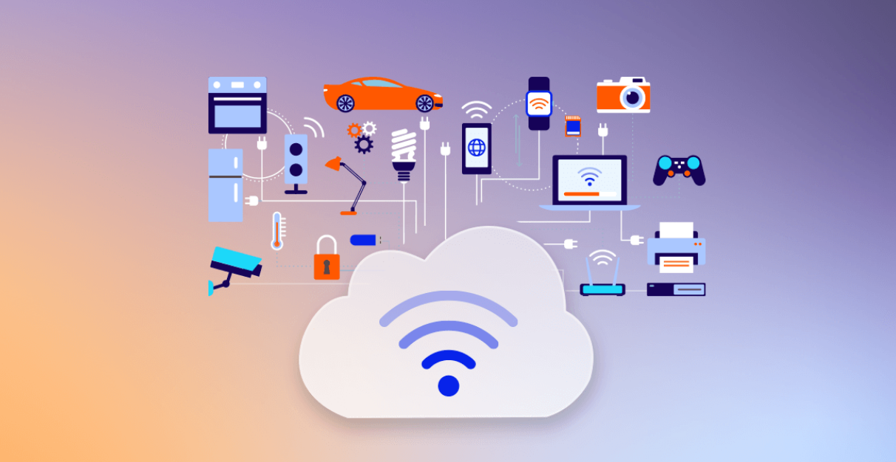
Page 02
About
INTERNET OF THINGS (IOT)
The Internet of Things (IoT) represents the convergence of physical hardware and digital software, allowing everyday objects to collect and exchange data. For a career aspirant, this domain offers a unique blend of electronics, networking, cloud computing, and data analytics.

Slide 4


Page 03
1. DEVICE HARDWARE (THE "THINGS")
key
Microcontrollers (MCUs): The brains of IoT devices. Popular learning tools include Arduino and ESP32, while industry standards include ARM Cortex-M series and STMicroelectronics chips.
Sensors & Actuators: * Sensors collect data (Temperature, Humidity, Accelerometers, GPS).
Actuators perform actions (Motors, Switches, Valves).
Single Board Computers (SBCs): More powerful processing units like the Raspberry Pi or NVIDIA Jetson for edge AI tasks.
TECHNOLOGIE
To build a career in IoT, one must understand the full "IoT Stack," which consists of four main layers:
2. CONNECTIVITY & PROTOCOLS
How devices talk to each other and the cloud.
Short Range: Bluetooth Low Energy (BLE), Zigbee, Z-Wave, NFC.
Long Range (LPWAN): LoRaWAN (Long Range Wide Area Network), Sigfox, NB-IoT (Narrowband IoT).
Data Protocols: * MQTT (Message Queuing Telemetry Transport): The standard for lightweight messaging in IoT.
CoAP (Constrained Application Protocol): Designed for simple electronics.
HTTP/REST: Standard web protocols used for API integration.

Slide 5
Page 04
key
TECHNOLOGIE
3. IOT PLATFORMS (CLOUD & EDGE)
4. ANALYTICS & APPLICATIONS
Where the data goes to be processed and managed.
Major Cloud Platforms: AWS IoT Core, Microsoft Azure IoT Hub, and Google Cloud IoT.
Edge Computing: Processing data locally on the device (e.g., using AWS Greengrass) to reduce latency before sending it to the cloud.
Data Visualization: Dashboards (Grafana, PowerBI, Tableau) to make sense of sensor data.
Machine Learning (AIoT): Applying AI to IoT data for predictive maintenance or anomaly detection.

Slide 6

Page 05
A) ONE INDIAN EXAMPLE:
SMART AGRICULTURE
(ANDHRA PRADESH AGTECH)
B) ONE GLOBAL EXAMPLE: INDUSTRIAL IOT (ROLLS-ROYCE "POWER BY THE HOUR")
real -world
THE PROBLEM: FARMERS IN DROUGHT-PRONE REGIONS OF ANDHRA PRADESH FACED UNPREDICTABLE WEATHER AND CROP FAILURES.
THE PROBLEM: FARMERS IN DROUGHT-PRONE REGIONS OF ANDHRA PRADESH FACED UNPREDICTABLE WEATHER AND CROP FAILURES.
USE CASES
.
THE SOLUTION: THE STATE GOVERNMENT PARTNERED WITH MICROSOFT TO DEPLOY AN AI-BASED SOWING APP.
HOW IT WORKS: * GROUND SENSORS MEASURE SOIL MOISTURE AND HEALTH.
THIS DATA IS COMBINED WITH SATELLITE IMAGERY AND HISTORICAL WEATHER DATA IN THE CLOUD.
FARMERS RECEIVE SIMPLE SMS ALERTS IN THEIR LOCAL LANGUAGE TELLING THEM THE OPTIMAL TIME TO SOW SEEDS.
IMPACT: THIS LED TO A 30% INCREASE IN CROP YIELDS IN PILOT VILLAGES WITHOUT ADDING SIGNIFICANT CAPITAL COSTS FOR THE FARMERS.
THE SOLUTION: THE STATE GOVERNMENT PARTNERED WITH MICROSOFT TO DEPLOY AN AI-BASED SOWING APP.
How it Works: * Ground sensors measure soil moisture and health.
This data is combined with satellite imagery and historical weather data in the cloud.
Farmers receive simple SMS alerts in their local language telling them the optimal time to sow seeds.
Impact: This led to a 30% increase in crop yields in pilot villages without adding significant capital costs for the farmers.

Slide 7
Page 06
career
OPPORTUNITIES
The IoT market is projected to grow exponentially, creating demand for specialized roles.
1. POSSIBLE JOB ROLES
2. INDUSTRY DEMAND
IoT Solutions Architect: Designs the overall end-to-end system, deciding which hardware, protocols, and cloud services to use. (High Seniority)
Embedded Systems Engineer: Focuses on the device side—writing firmware (C/C++) that runs on microcontrollers.
IoT Network Engineer: Specializes in connectivity, ensuring devices stay connected via 5G, LoRaWAN, or Wi-Fi in difficult environments.
IoT Data Scientist: Analyzes the massive streams of time-series data coming from sensors to find patterns.
IoT Security Specialist: Critical role involved in securing devices that are notoriously vulnerable to hacking.
Smart Manufacturing (Industry 4.0): Highest demand for engineers who can connect legacy factory machines to the cloud.
Healthcare (IoMT): Remote patient monitoring devices are surging in popularity.
Smart Cities: Governments are hiring for traffic management, waste management, and energy grid modernization.
Automotive: Connected cars and EV charging infrastructure.

Slide 8
Page 07
required
SKILLS CHECKLIST
PROGRAMMING
HARDWARE
CLOUD
NETWORKING
SECURITY
C/C++ (Firmware),
Python (Data/Scripting), Node.js (Backend)
Basics of electronics,
GPIO pins, soldering, reading datasheets
Experience with AWS or Azure specific IoT services
Understanding TCP/IP, MQTT, API structures (REST/GraphQL)
Encryption (SSL/TLS), Device Identity Management

Slide 9
Page 08
reference
FURTHER READING
Thank You
Journals: IEEE Internet of Things Journal.
Industry Reports: Gartner "Hype Cycle for IoT", McKinsey Global Institute reports on Industry 4.0.
Blogs: Hackster.io (for projects), IoT For All, AWS IoT Blog.
GeeksforGeeks (Top IoT Careers)
India Today (Job Market Analysis)
Scribd (Andhra Pradesh Smart Agriculture)
i-SCOOP (Rolls-Royce & Global Cases)
Wikipedia

